Slide 1
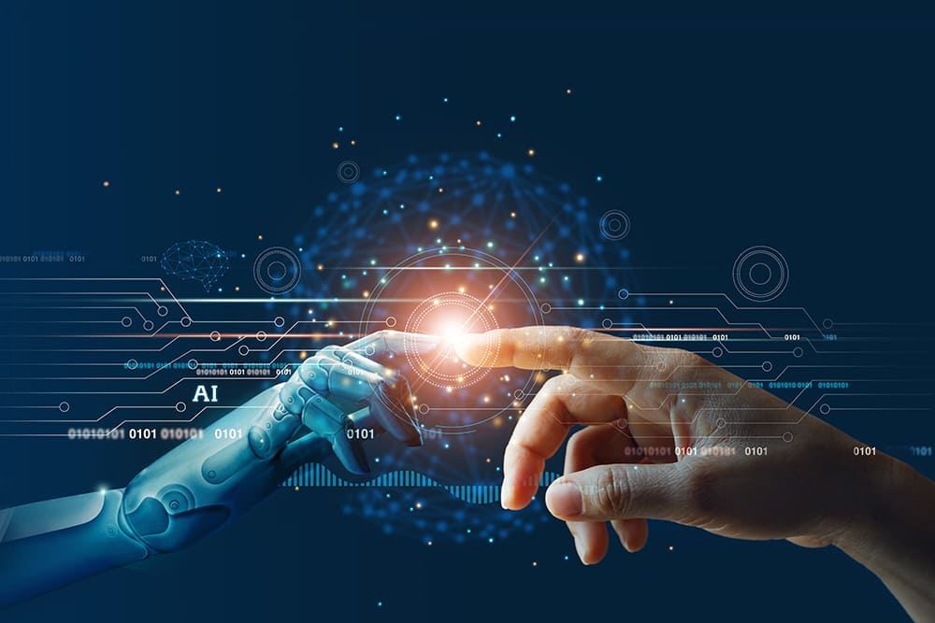
Health Roof
CAPSTONE PROJECT
FALL SEMESTER 2022-23
Review 1
All in One Solution

Slide 2
Guided By- Prof. D.Sumathi Mam
Done By-​
Y.Avinash Mani Kiran – 19BCE7466​
S.Lakshmi Prasanna – 19BCE7317​
M.Amulya - 19BCE7752

Slide 3
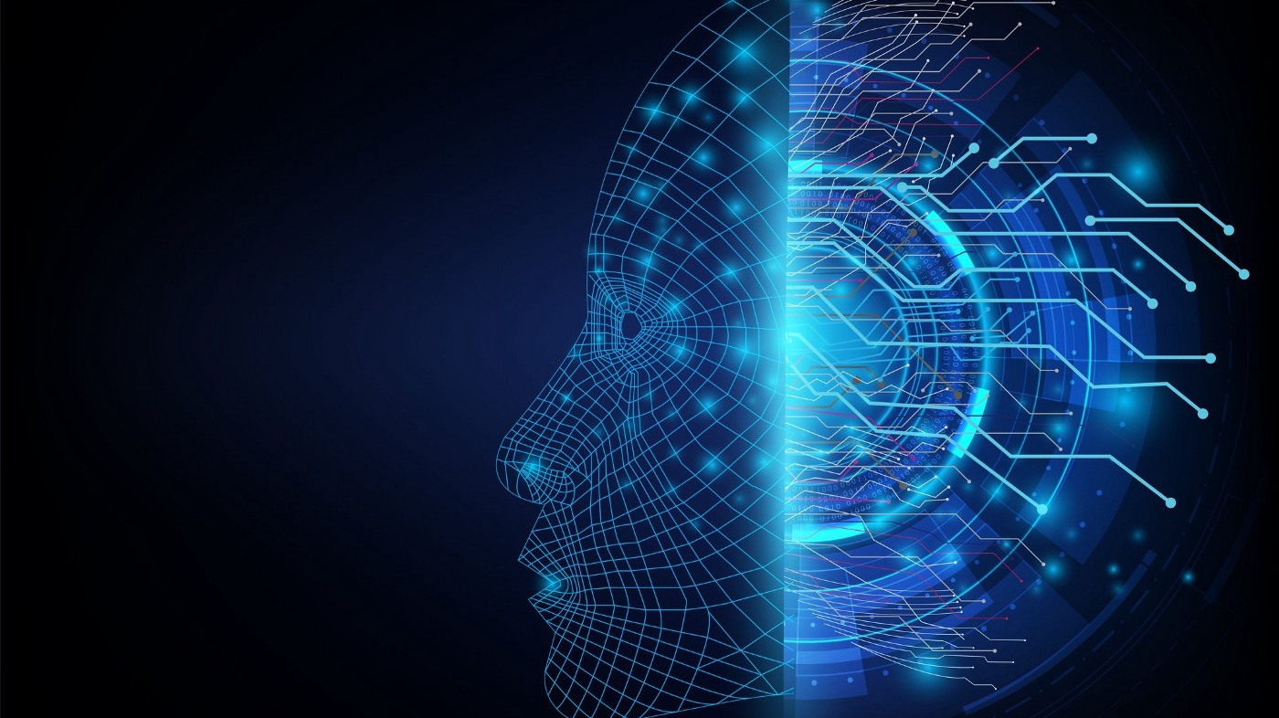
Motivation
Recently the time has been difficult for all of us and every second person around is suffering from one or the other disease, that’s why we tried to bring everything under one platform.
The main advantage of this project is that we can get the test results immediately at our home with a just few clicks.
The future is all about AI so here we present our idea of bringing 7 disease detections under one roof using the power of AI.

Slide 4
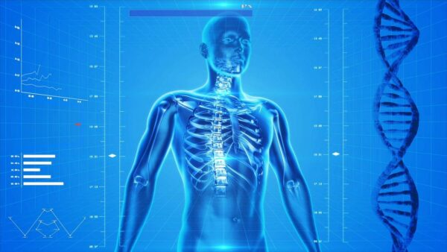
Objective
Integration of Artificial Intelligence with medical field
Making disease detection a click away
The idea of creating an online platform where we brought together all of these disease detections under the one roof.
It contains both simple and advanced type of detection

Slide 5
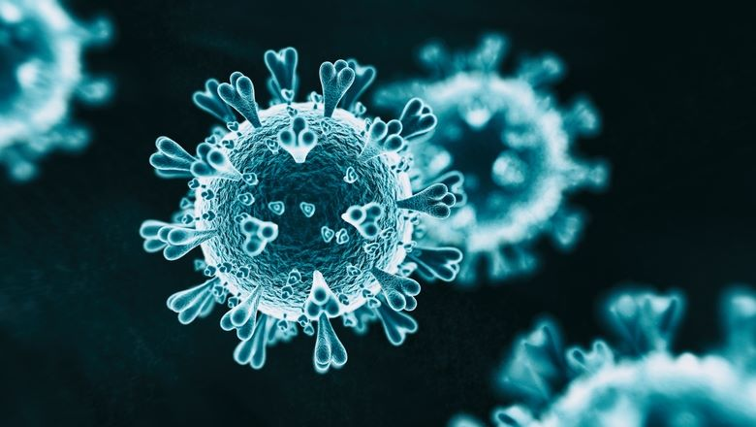
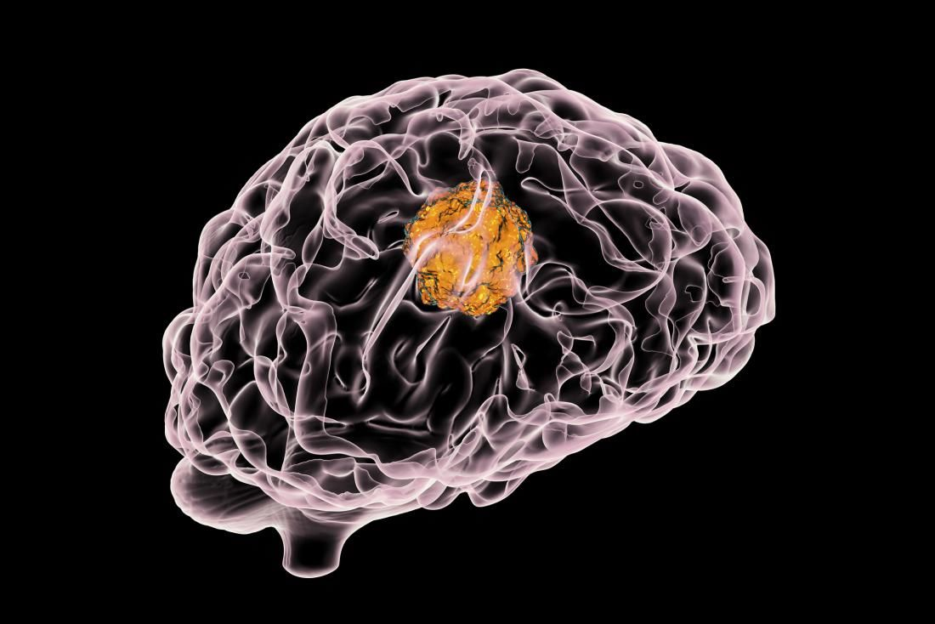
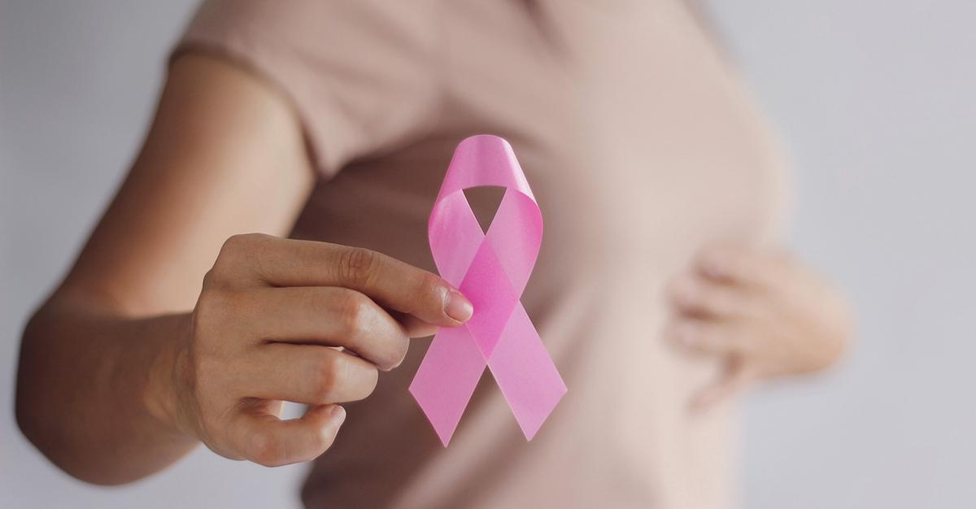
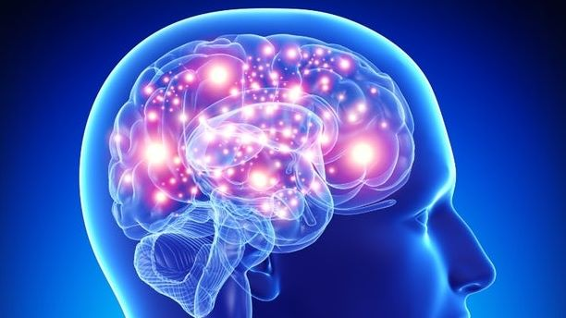
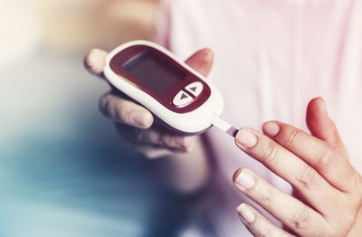
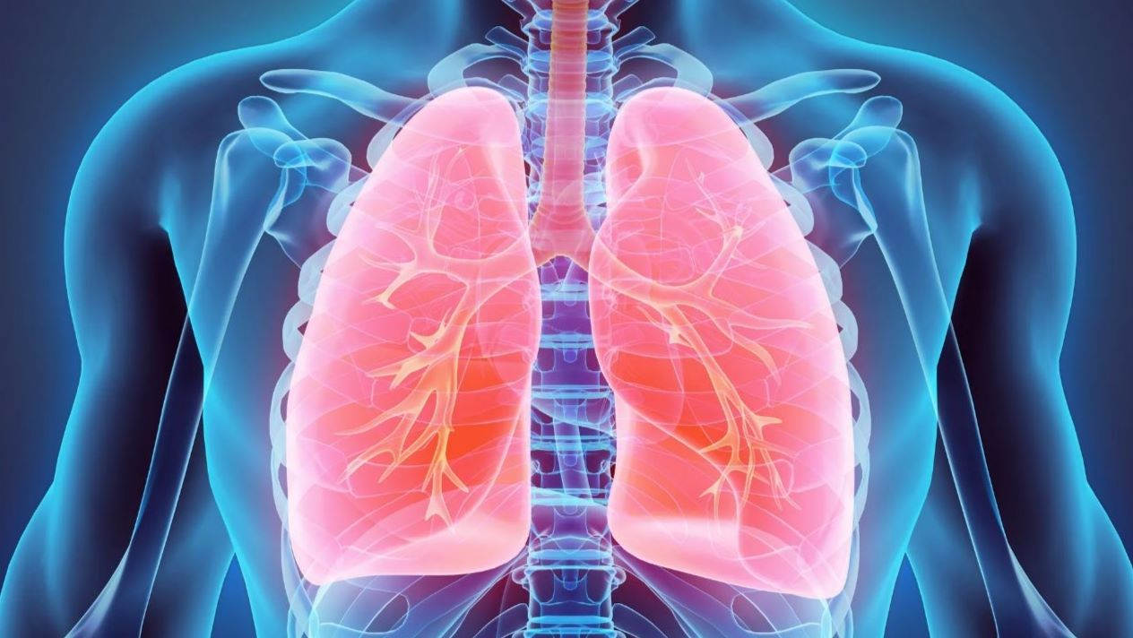
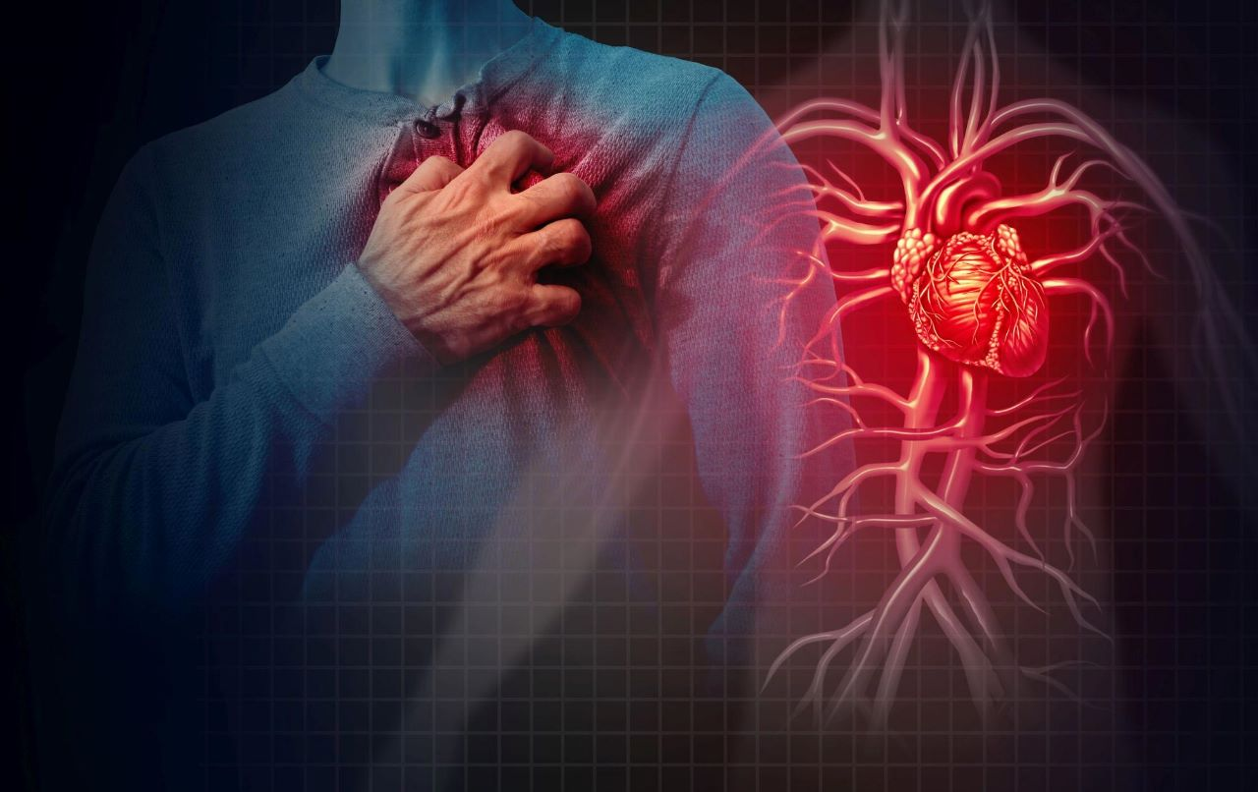
7 Disease Detections:
Covid-19 detection
Brain Tumour detection
Breast Cancer detection
Alzheimer detection
Diabetes detection
Pneumonia detection
Heart disease detection

Slide 6

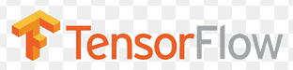



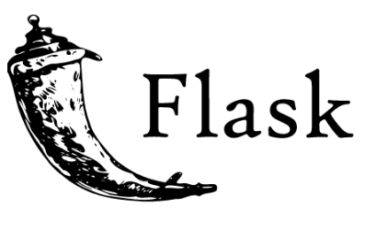


Requirements
Software:
Python (version 3.6 or higher)
Anaconda (for various python libraries)
Tensorflow-gpu
Flask(backend)
Html(front end)
Visual Studio Code(IDE)
OpenCV
Hardware:
•Laptop
CSS

Slide 7
Time Plan
Review 1
Review 2
Implementation of algorithms and UI of input forms
Review 3
Gathering the information regarding project ,identifying the tools ,studying about the best algorithm to use
Complete implementation and displaying results
Final Review
Includes detailed description of project

Slide 8

Convolutional Neural Network
A Convolutional Neural Network (ConvNet/CNN) is a Deep Learning algorithm which can take an input image, assign importance to various aspects/objects in the image and be able to differentiate one from the other.

Slide 9
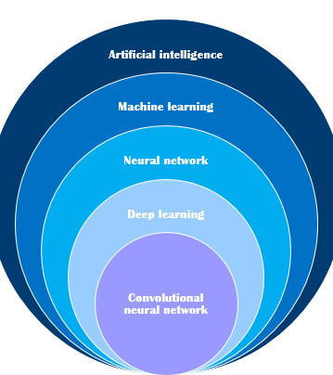
Why CNN?
Less pre-processing is required
Successfully captures Spatial and Temporal dependencies
Reduces images without losing features

Slide 10
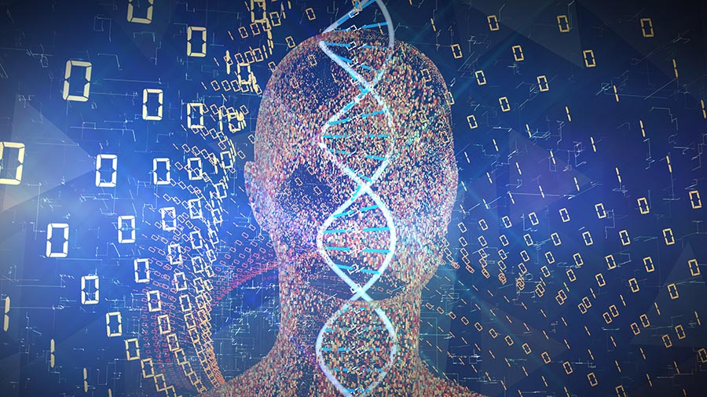
THANK YOU

